Slide 1
Product Layout
Layout, UI ideas

Slide 2
Splash Screen
Company Logo Here

Slide 3
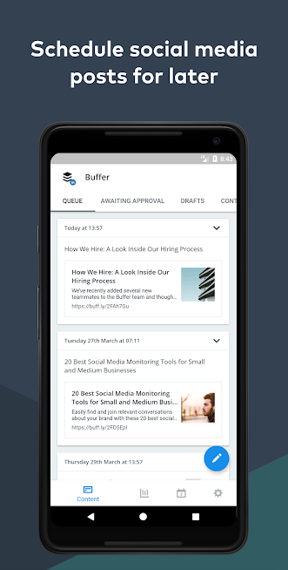
Homepage

Slide 4
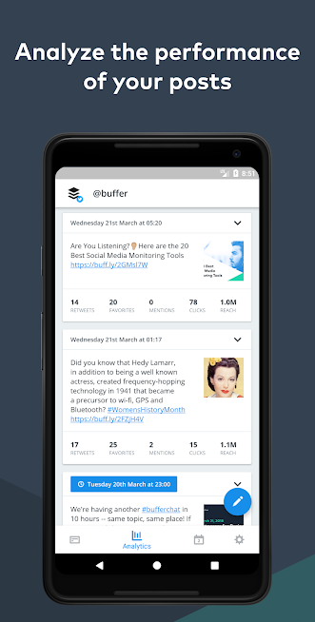
Post Scheduling and Analytics

Slide 5
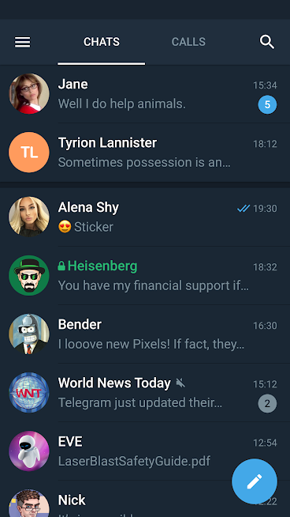
Switching accounts and New posts

Slide 6
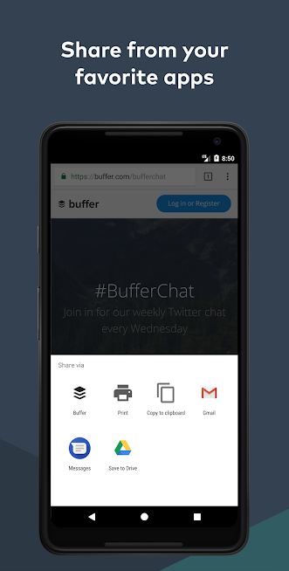
Sharing through app

Slide 7
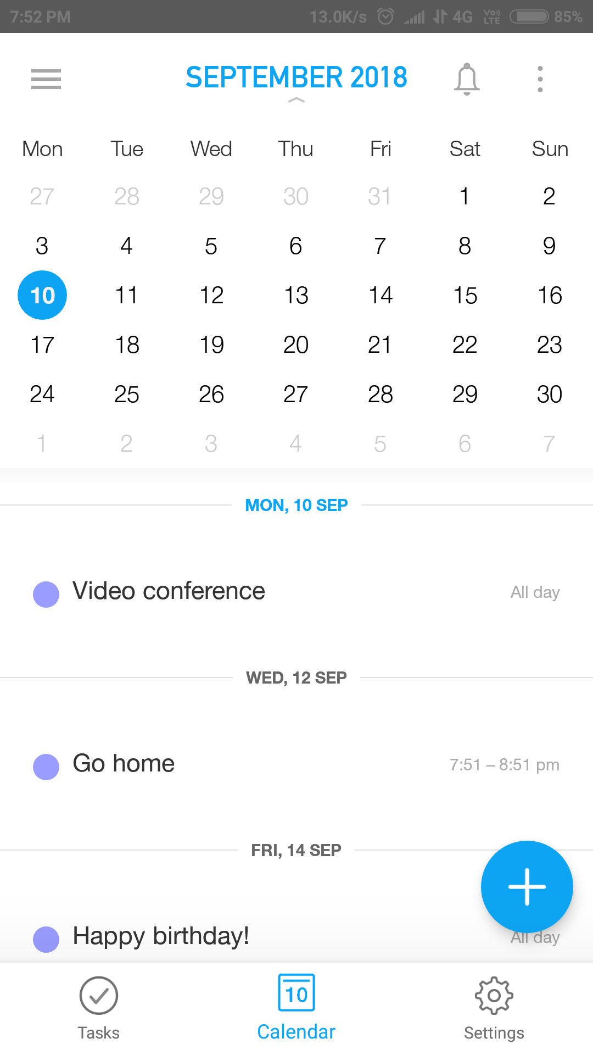
Calendar(To schedule posts)

Slide 8
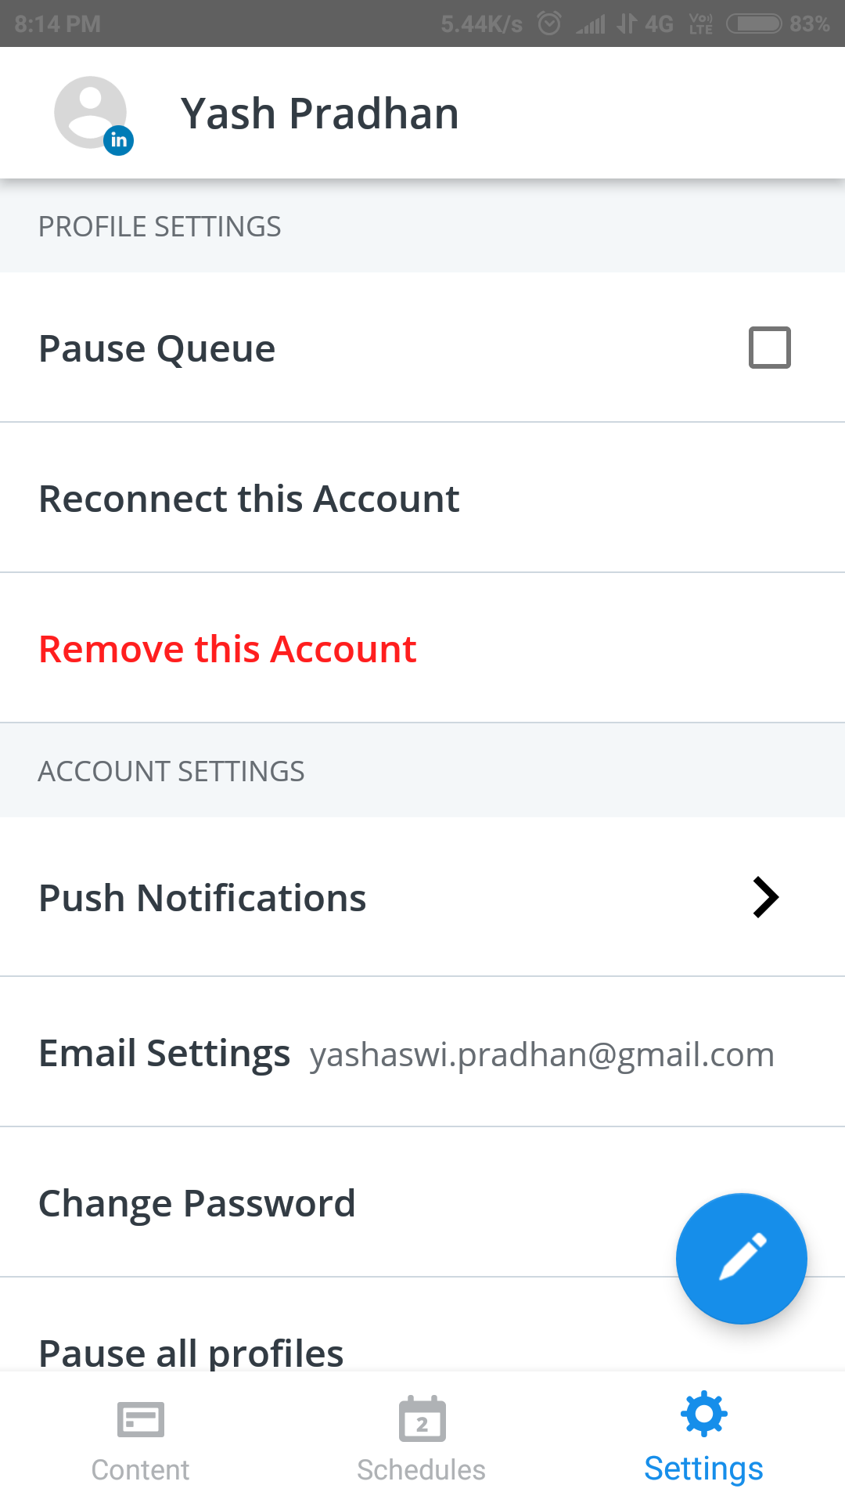
Settings

Slide 9
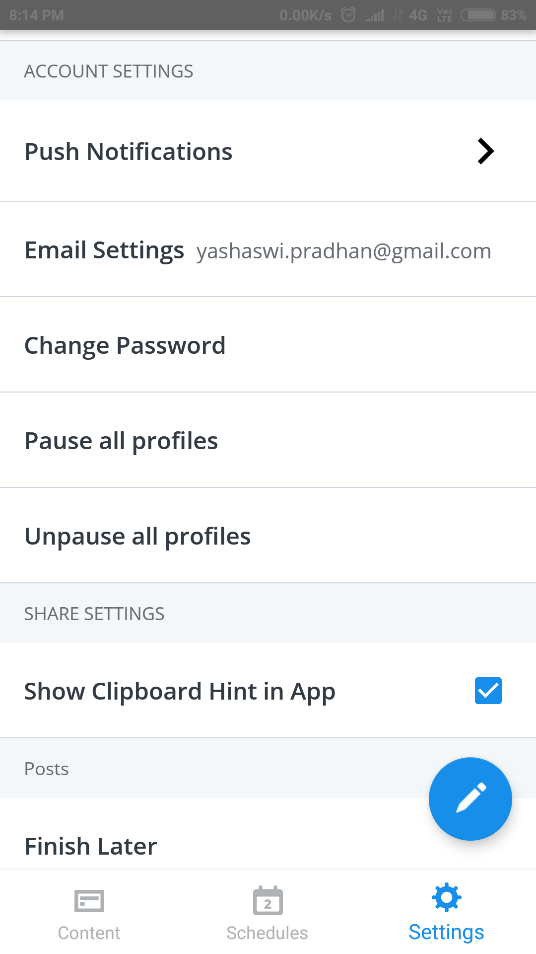
Settings

Slide 10
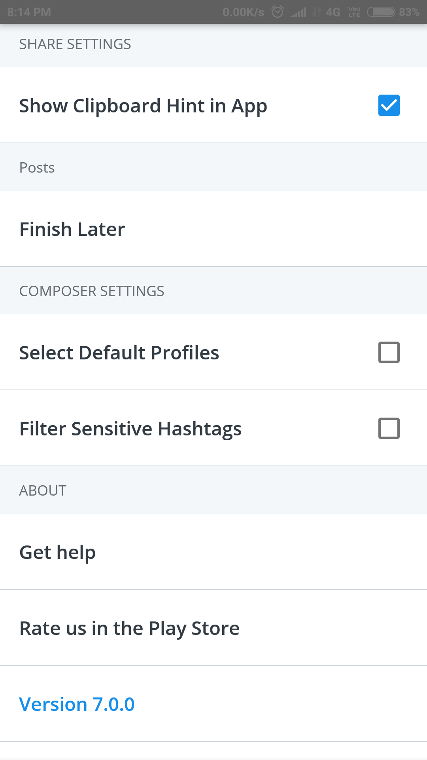
Settings

Slide 11
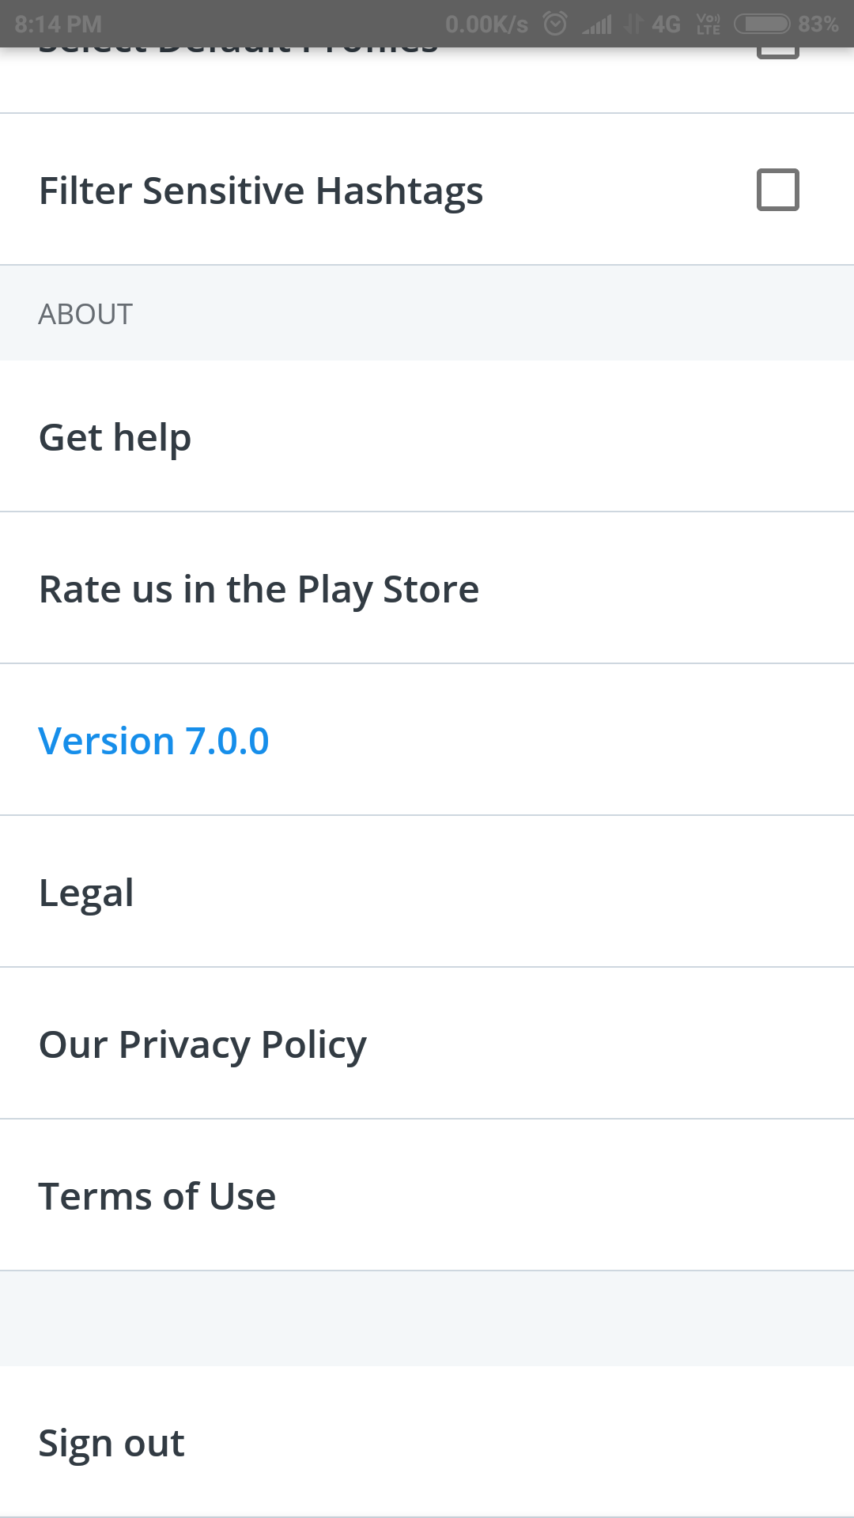
Settings

Slide 12
Payment System
Payment method must be bi-directional
It must receive payment from pro members.
It must send money to the users after each post analytics.
Payment gateway client is Stripe.
Paytm integration

Slide 13
Referral System
Refer and earn for all users.

